Slide 1
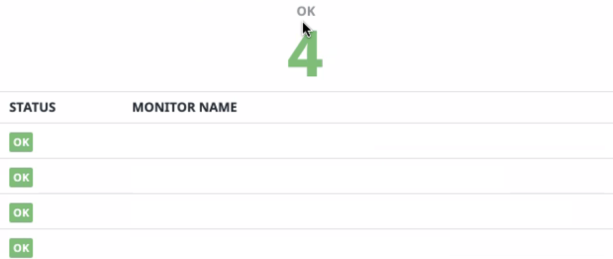
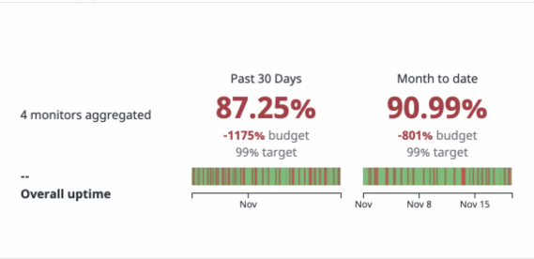
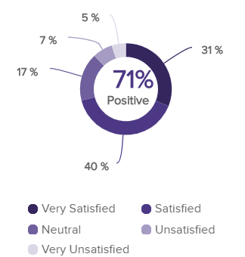
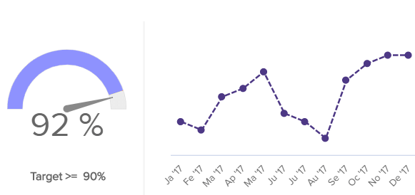
SLI Monitor
Data Pipeline Reliability
[SL1] Total-data-processed
[SL2] Time-to-detection
[SL3] Time-to-resolution
[SL4] Average-down-time
Customer-Retention
Customer-Satisfaction

Slide 2
Data Quality Dashboard
This dashboard is a sample representation of a typical dashboard for visualization of data analytics.
The ideal tool for this will be Tableau or Power BI or something of that nature.
Real data will be supplied, loaded and analyzed.
The dashboard will be constructed similarly using the supplied data
Image source:https://www.datapine.com/dashboard-examples-and-templates/customer-service

